Slide 1




Agile QA Practices
A course from
ThoughtWorks Studios

Slide 2
Stand-up
What did I learn yesterday
What is my learning objective today

Slide 3
Initiation (Iteration 0)
Phase 2 of an agile project
Initiation
Evolve/Hand over…
Inception
Develop and deliver

Slide 4
Iteration 0 and QA
Help team determine “done” for stories, iterations
Get familiar with technology
Spike an automated test
Plan for iteration 1

Slide 5
What is “done”?
Common, objective understanding across team of completeness
No notion of “code complete”
Done criteria for stories, iterations and releases
Only push of a button needs to happen before story/iteration/release is deployed in production
Developed in conjunction with business

Slide 6
Done criteria examples
All tests (unit, functional, integration) pass
Exploratory tested
Integrated into trunk
In pre-prod environment
Demoed to stakeholder
Meets all cross-functional requirements
Databases are migrated

Slide 7
What is “done”?
Iteration 0 task 1
Notes:
What does it mean to be done with a story?
With an iteration?

Slide 8
Get familiar with Technology
Development practices that are useful for QA

Slide 9

Continuous Integration
“The key is to automate absolutely everything and run the process so often that integration errors are found quickly.” -- Martin Fowler

Slide 10
Continuous Integration
Core practices
Check in regularly
Create comprehensive automated test suite
Keep the build and test process short
Don’t check in on a broken build
Run all commit tests locally after updating, before committing
Never go home on a broken build (but be prepared when someone does)
Always be prepared to revert to previous revision
Don’t comment out failing tests/assertions
Visual build monitor

Slide 11
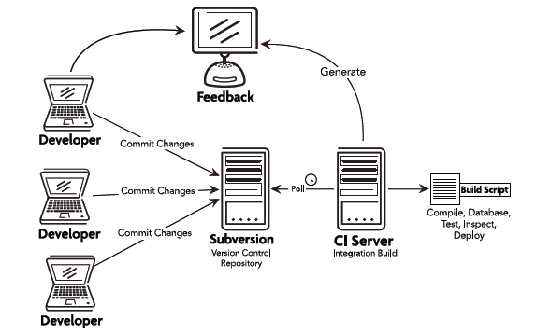
Continuous Integration
Notes:
Starts with a team member committing source code to the repository
Required features:
CI server
Version control system that is accessible from CI server
Automated build script that includes tests
Build monitor
Agreement of the team

Slide 12
What is a successful build?
All the latest sources are checked out of the configuration management system
Every file is compiled from scratch
The resulting compiled code is put into binaries
The system is started and suite of tests is run against the system
Notes:
If all of these steps execute without error or human intervention and every test passes, then we have a successful build

Slide 13
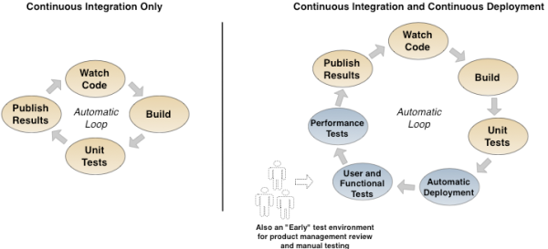
Continuous Integration and Deployment

Slide 14
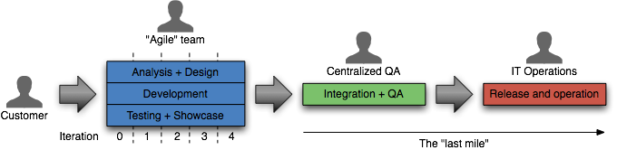
Continuous delivery
Traditional approach to delivery
Ideal approach to delivery
Notes:
How long would it take your organization to deploy a change that involves just one single line of code. – Mary and Tom Poppendieck
Do you do this on a repeatable, reliable basis?
Ideal
Software always production-ready
Reliable deployments
Everyone can self-service deployments
Business drives releases: Releases tied to business needs, not operational constraints
Principles
Create a repeatable process for releasing software
Automate almost everything
Keep everything in version control
If it hurts, do it more often, and bring the pain forward
Build quality in (Deming)
Done means released
Everybody is responsible for delivery
Continuous improvement
Practices
Only build your binaries once
Deploy the same way to every environment
Smoke test your deployments
Keep your environments similar
If anything fails, stop the line

Slide 15
Spike an automated test
Iteration 0 task 3

Slide 16
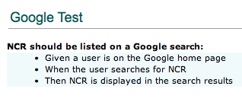
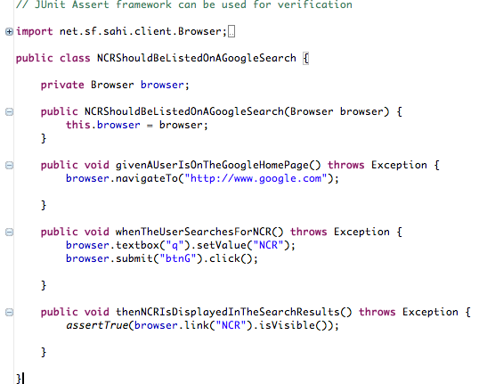
Functional test example

Slide 17
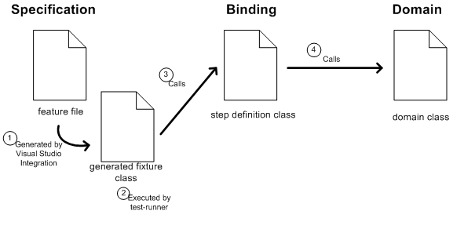
Functional Testing
Behavior-driven development frameworks
Notes:
Answers important strategic questions:
How can tests be executed early and often enough to mitigate risk?
How can tests be maintained as long-lived, evolving, and reusable assets?
How can testing involve all the stakeholders in the software development process such that requirements are fully understood and tested?
How can the highest value most essential testing be identified?
Functional test automation is not an end unto itself – it’s a tool and a capability
Automation does a few things very well:
Makes regressions run faster, freeing testers up to think, not click
Allows for running tests in different environments and on different platforms
Shores up the safety net
Extends your capacity to cover different testing models
Gives fast feedback to teams
Reduces the defects that make it to production by providing frequent regression checks
Makes requirements clearer by giving developers executable acceptance tests
Automation does not:
Find all of the bugs a user might encounter
Find logical inconsistencies, performance, security or UX problems in the application
Cover all boundary conditions, particularly at higher levels
Many organizations believe that unit tests are a panacea for software quality
Unit tests are good at a few things:
Preserving developer intention
Helping developers design code better
Helping developers think through boundary conditions
Unit tests aren’t good at:
Checking integration between components
Validating that software works from a user perspective
Finding unanticipated errors
Covering all boundary conditions
Brittleness
Maintainability
Time Required
Not inherently collaborative

Slide 18
What is Functional Testing?
Answers the question of "can the user do this" or "does this particular feature work”
Business-facing, product-facing tests
Tests that prove you “built the right thing” (as opposed to “built the thing right”)
Notes:
AKA Story tests, customer tests

Slide 19
What is Functional Testing?
Types of Functional Tests
End-to-end testing (i.e., does the application work all the way through)
Regression tests that reflect a particular defect found in production
Testing "from a user perspective", which includes acceptance tests
Acceptance testing is particularly relevant in Agile
Guarantees that the requirement as specified is implemented in the software
Some teams use Acceptance test driven development
All functional tests are not acceptance tests however

Slide 20
What is unit testing?
Per Michael Feathers, it’s not a unit test if:
It talks to the database
It communicates across the network
It touches the file system
It can't run at the same time as any of your other unit tests
You have to do special things to your environment (such as editing config files) to run it
Notes:
Broad Definition: Tests that verify the behavior of a small part of the overall system.
Commonly, Unit Tests map to methods within an application’s code base. They’re typically implemented by the developers writing the application code
Many organizations believe that unit tests are a panacea for software quality
Unit tests are good at a few things:
Preserving developer intention
Helping developers design code better
Helping developers think through boundary conditions
Unit tests aren’t good at:
Checking integration between components
Validating that software works from a user perspective
Finding unanticipated errors
Covering all boundary conditions

Slide 21
Plan for iteration 1
Iteration 0 task 4

Slide 22
Detail is commensurate with plan horizon
Themes
Epics
Stories
Tasks
Home Page
Search Results
Full Page Ad
Featured Listing
Search Form
Classified Results
Billing
Dealer Groups
Display Logic
Click Counting
Matching Search Criteria
Choosing a Dealer
Choosing an Ad
Etc…

Slide 23
Elicit detail just in time

Slide 24
Story attributes
INVEST
Independent
Negotiable
Valuable
Estimatable
Small
Testable
3 C’s (Card, Conversation, Confirmation)

Slide 25

Writing acceptance criteria
Collaborative
How will you know when we’re finished?
Multiples per story
All or nothing
Notes:
Use the Wisdom of Crowds approach to defining.
Diverse set of independent individuals
Maximise the effectiveness of decision making process
BA, Biz, Devs, QA all participate in defining the acceptance criteria
----------------------------------------------------------------------------------------------------------------------------------------
If you have attended the Leadership or Project Management training, you will recall the concept of Collective Wisdom, or Wisdom of the Crowds. In short, collective wisdom demands the use of a large, diverse set of independent individuals to maximise the effectiveness of decision making processes. This same approach should be considered for acceptance criteria in order to obtain the best coverage of criteria across the requirement. Developers, analysts, architects and testers should all be able to provide useful input to generating acceptance criteria.
If you don’t have any background information on these topics, try http://en.wikipedia.org/wiki/Collective_wisdom or http://en.wikipedia.org/wiki/The_Wisdom_of_Crowds .
REMOVED
Derived with the customer and someone technical to provide feasibility
Ask the customer: What will you observe when the story is successfully complete?
Use Wisdom of Crowds
Most stories will generate multiple criteria
All must be met before the story can be completed
Consider using a template

Slide 26
Acceptance criteria
Given <context>
When <action>
Then <expectation>

Slide 27
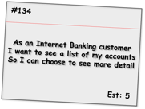
Acceptance criteria examples
Given the customer has one transaction account and one credit account
When they have completed logging in
Then the screen should show the names and numbers of the two accounts sorted in account number order
Given the customer has just one transaction account
When they have completed logging in
Then the screen should show the name and number of the account
Given the customer has no accounts
When they have completed logging in
Then the screen should show a message stating that no accounts are available
Given the customer has more than 20 accounts
When they have completed logging in
Then the screen should show the first 20 accounts (in account number order) only
Given the customer has some accounts
When they have completed logging in
And the system cannot retrieve the account details
Then the screen should show an error message with associated code and details to contact for support
Alternate path
Alternate path
Bad path
Notes:
This format is iteration level acceptance criteria vs. Inception level.
Shows positive, alternate and bad paths.
Talk through each one.
-----------------------------------------------------------------------
Here we see a set of criteria for an Internet Banking story covering a range of positive, alternate and bad paths through the requirement. As is expected, the positive paths map directly to the requirements as stated and assume everything is working as expected.
The alternate path criteria describe non-standard ways to meet the desired outcome, which although may not be considered within the narrative of the story, are still reasonable to assume as usage patterns for the system.
Bad path criteria describe situations in which the outcome cannot be achieved, in this case how the system would behave in the case of an internal error.

Slide 28
Add acceptance criteria to iteration 1stories
Pre-iteration planning

Slide 29


Slide 30
Develop and deliver
Phase 3 of an agile project
Initiation
Evolve/Hand over…
Inception
Develop and deliver

Slide 31
Stand-up
What did I learn yesterday
What is my learning objective today

Slide 32
Review: The iteration
Daily stand-up
Release backlog
Prioritized subset
Release planning
Pre-iteration planning/
backlog grooming
Iteration planning/ kickoff
Showcase + Retrospective
Working software
Notes:
Story Backlog
List of stories for the entire project
Prioritized sub set
Prioritized for the next Iteration
Whole team
IPM
No waste
IKO
Clarify
Task
Estimate
Stand up
Short
Yesterday, today, blockers
Chickens and pigs
Showcases
Present working software
Sometimes give customer a play environment too
Customer gives feedback
New stories?
Re-plan?
Retrospective
Well, not so well
Constant improvement

Slide 33
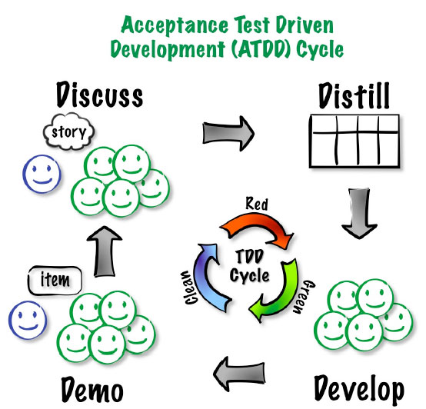
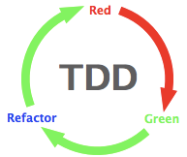
Driving with acceptance tests
- ATDD image from Elisabeth Hendrickson
Notes:
Answers important strategic questions:
How can tests be executed early and often enough to mitigate risk?
How can tests be maintained as long-lived, evolving, and reusable assets?
How can testing involve all the stakeholders in the software development process such that requirements are fully understood and tested?
How can the highest value most essential testing be identified?
Functional test automation is not an end unto itself – it’s a tool and a capability
Automation does a few things very well:
Makes regressions run faster, freeing testers up to think, not click
Allows for running tests in different environments and on different platforms
Shores up the safety net
Extends your capacity to cover different testing models
Gives fast feedback to teams
Reduces the defects that make it to production by providing frequent regression checks
Makes requirements clearer by giving developers executable acceptance tests
Automation does not:
Find all of the bugs a user might encounter
Find logical inconsistencies, performance, security or UX problems in the application
Cover all boundary conditions, particularly at higher levels
Many organizations believe that unit tests are a panacea for software quality
Unit tests are good at a few things:
Preserving developer intention
Helping developers design code better
Helping developers think through boundary conditions
Unit tests aren’t good at:
Checking integration between components
Validating that software works from a user perspective
Finding unanticipated errors
Covering all boundary conditions
Brittleness
Maintainability
Time Required
Not inherently collaborative

Slide 34
ATDD cycle

Slide 35
ATDD cycle

Slide 36
ATDD cycle

Slide 37
ATDD cycle

Slide 38
ATDD cycle

Slide 39
ATDD cycle

Slide 40
Functional Testing
Given <initial context>
When <action>
Then <expected result>
Notes:
Answers important strategic questions:
How can tests be executed early and often enough to mitigate risk?
How can tests be maintained as long-lived, evolving, and reusable assets?
How can testing involve all the stakeholders in the software development process such that requirements are fully understood and tested?
How can the highest value most essential testing be identified?
Functional test automation is not an end unto itself – it’s a tool and a capability
Automation does a few things very well:
Makes regressions run faster, freeing testers up to think, not click
Allows for running tests in different environments and on different platforms
Shores up the safety net
Extends your capacity to cover different testing models
Gives fast feedback to teams
Reduces the defects that make it to production by providing frequent regression checks
Makes requirements clearer by giving developers executable acceptance tests
Automation does not:
Find all of the bugs a user might encounter
Find logical inconsistencies, performance, security or UX problems in the application
Cover all boundary conditions, particularly at higher levels
Many organizations believe that unit tests are a panacea for software quality
Unit tests are good at a few things:
Preserving developer intention
Helping developers design code better
Helping developers think through boundary conditions
Unit tests aren’t good at:
Checking integration between components
Validating that software works from a user perspective
Finding unanticipated errors
Covering all boundary conditions
Brittleness
Maintainability
Time Required
Not inherently collaborative

Slide 41
Acceptance-testing defects
Given <initial context>
When <action>
Then <expected result>
Rather than <unwanted behavior>

Slide 42
Functional Testing
Automating Functional Tests
Functional Test Automation Makes Testing an Asset
Living documentation
Why Functional Test Automation?
Unit Testing is Fundamentally Different
Automated Testing Has Additional "Gotchas"
Notes:
Answers important strategic questions:
How can tests be executed early and often enough to mitigate risk?
How can tests be maintained as long-lived, evolving, and reusable assets?
How can testing involve all the stakeholders in the software development process such that requirements are fully understood and tested?
How can the highest value most essential testing be identified?
Functional test automation is not an end unto itself – it’s a tool and a capability
Automation does a few things very well:
Makes regressions run faster, freeing testers up to think, not click
Allows for running tests in different environments and on different platforms
Shores up the safety net
Extends your capacity to cover different testing models
Gives fast feedback to teams
Reduces the defects that make it to production by providing frequent regression checks
Makes requirements clearer by giving developers executable acceptance tests
Automation does not:
Find all of the bugs a user might encounter
Find logical inconsistencies, performance, security or UX problems in the application
Cover all boundary conditions, particularly at higher levels
Many organizations believe that unit tests are a panacea for software quality
Unit tests are good at a few things:
Preserving developer intention
Helping developers design code better
Helping developers think through boundary conditions
Unit tests aren’t good at:
Checking integration between components
Validating that software works from a user perspective
Finding unanticipated errors
Covering all boundary conditions
Brittleness
Maintainability
Time Required
Not inherently collaborative

Slide 43
Agile test automation
Why and how we automate
Notes:
“Good” test automation is good. “Bad” test automation is worse than none, discuss why.
Automation Definition:
Wikipedia says, “is the use of control systems in concert with other applications of information technology, to control industrial machinery and processes, reducing the need for human intervention”
Test Automation Definition:
Test automation is the use of software to control the execution of tests, the comparison of actual outcomes to predicted outcomes, the setting up of test preconditions, and other test control and test reporting functions. Commonly, test automation involves automating a manual process already in place that uses a formalized testing process.

Slide 44
Why automate?
Provide fast feedback to the team
Serve as safety net, provide confidence
Facilitate repeatable testing
Optimize manual testing
Verify business case
Reduce mundane tasks
Notes:
Agile development depends on a high level of test automation in order to provide fast feedback loops to the development team
Another reason why to automate is to have repeatable testing i.e. being able to run something and do the exact same thing again 6 months down the line.
The feedback that automation provides improves the confidence that all team members have about the quality of the software
Once you see a green bar for your functional test suite, developer is confident about his checkin
Faster feedback is one of the pillars of agile - automation helps to achieve the same.
In due course of time, your functional test suite tend to grow big and complex, and in turn takes longer to execute which leads to not getting quicker feedback.
Basic thumb rule is your primary build should not take more than 10-15 mts including compile, build, unit tests and functional tests.
So, what you can do is:
1. Break your large test suite into smaller ones, like smoke, high, medium, low. Include may be smoke and high tests in the primary build and everything else can be moved to secondary build or execute once in every 2 hours or ....
2. Execute test suites in parallel using multiple machines - But the catch is the tool should have support for this.
Bad candidates for automation
Tests that require visual checks
Tests that are extremely complicated to automate from a development perspective (sometimes it makes sense to do these if manual is worse)
Sometimes the recurring cost to manually test something is still lower than the automation costs in the near term
Tests that touch stubs/spikes/throwaway code

Slide 45
What’s different in agile?
Automation happens as part of development
Automate acceptance tests, more than end-to-end tests (in general)
Automated tests form a regression test suite and are executed in CI to give faster feedback

Slide 46
Who automates?
Shared responsibility of the team = much more likely to succeed
Feedback improves the confidence of all team members in the quality of the software
Shared ownership leads to an understanding of the tests
Avoids a false confidence in automation
Notes:
Agile development depends on a high level of test automation in order to provide fast feedback loops to the development team
When automation is the shared responsibility of the team and not just that of the testers or the developers it is much more likely to succeed
Most tests can be automated and should be if the feedback provided is valuable to the team as a whole
When bugs are found automated tests can be added to the regression test suite so the bugs are not repeated
The feedback that automation provides improves the confidence that all team members have about the quality of the software
Shared ownership leads to an understanding of what the automated tests are actually testing
When the team understands the nature of the tests the confidence provided by the existence of an automation suite is not a false confidence

Slide 47
Myths
Reduce head count
100% automation
ROI from day-1
Automation script can find more bugs
Notes:
You still need somebody to write/maintain test scripts. By automating, you cannot reduce head count of your team.
100% automation may not be possible because of - technical reasons, not worth etc.
Do not expect to get ROI from day-1 of automation
You cannot find bugs through your automation script. My client asked me, we have 4 people in automation and 1 person doing manual testing and he finds more bugs than 4 of us. Writing or maintaining automation script is not find bugs. Objective of automation is not to find bugs, rather it is to make sure that your existing functionalities are working.

Slide 48
Develop and deliver
Iteration 2
Initiation
Evolve/Hand over…
Inception
Develop and deliver

Slide 49
Automation Practices and Patterns
Functional Testing

Slide 50
Proven practices for test development
Separate intent from implementation (mechanics)
Test automation best practices = programming best practices:
Abstraction
Encapsulation
Refactoring
Don’t repeat yourself
Notes:
Abstraction: hide implementation details
Encapsulation: all of the object's data is contained and hidden in the object and access to it restricted to members of that class.

Slide 51
Proven practices for scenarios
Think (and specify) from the business perspective
Write tests for reusability
Refactor steps
Extract steps as you go
Rule of thumb for workflow – not more than 10 steps
Limit verifications and assertions in extracted steps
Notes:
describe a bit about user journeys: The statement about scripts having no more than 10 steps is good for acceptance tests, I'm thinking about the UAT/User Journey/E2E ones and whether it's worth having some description about them included
Concept
Logged in as admin
Go to login page
Type admin/admin
****
Tests
Call Logged in as admin
Asset: On x page/

Slide 52
Proven practices for user-interface tests
UI Changes
Xpath is difficult to maintain Avoid using xpaths
ID change Create constant IDs & reuse
Notes:
ID Changes – does this make sense
DRY Principle - e.g., Control type change -- list to combo

Slide 53
Challenges
Unstable Tests
Page synchronization
Waits
Data dependencies
Side-effects from tests
Order/group execution problems
Unclear Tests
Too many asserts
Test duplication
Unnecessary/duplicated setup
Notes:
Waits – don’t poll, go event based, use an explicit wait (selenium page model)

Slide 54
Page-object pattern
Encapsulate all of the actions a user can do or see on a page into a singular object
A product page would have things like, add to chart, add to gift register, related products, review, etc..
Typically relies on method chaining – methods in a page object always return another page object
Doesn’t need to reflect entire actual page

Slide 55
Page-object pattern
Positives
Makes code more readable
Makes a navigation map for your tests
Negatives
Breaks down in a few places
Assumes that your app page structure is designed well

Slide 56
Page-object pattern
Login Page
Add Customer Page
Add Movie Page
Membership Plan
Rent Movie Page
Return Movie Page
Search

Slide 57
Page-object pattern
public class LoginPage {
public void UserLogin() throws Exception {
# Login implementation
}}
public class AddCustomerPage {
public void AddCustomer() throws Exception {
# Add Customer implementation
# enter customer name
# enter customer ID
# submit customer info
}}
public class RentMoviePage {
public void RentMovie() throws Exception {
# Rent Movie implementation
# enter customer ID
# enter Movie Name
# submit Rental
}}

Slide 58
Domain-object pattern
Group all the actions associated with a specific domain concept like search or filtering in the application together.
Or, groups all the meaningful domain entities together, with relevant actions as methods
Makes your test suite look more like a library from a code perspective.
You can implement method chaining, but it requires a map of some sort, which is hard to maintain.

Slide 59
Domain-object pattern
Positives:
Helps with apps that have many cross-cutting concerns
Tests don’t represent the structure of the application, which is likely to change
Easy for new users to pick up
Negatives:
Not as elegant as the Page Object Pattern
More work to maintain

Slide 60
Domain-object pattern
ACTIONS
ENTITIES
Login
Movie
Add
Customer
Rent
Rental
Return
Membership Plan
Search

Slide 61
Domain-object pattern
public class Customer {
public void Add() throws Exception {
# Add Customer implementation
# enter customer name
# enter customer ID
# submit customer info
}}
public class Movie {
public void Add() throws Exception {
# Add Movie Implementation
}}
public class Rental {
public void Create() throws Exception {
# Rent Movie implementation
# enter customer ID
# enter Movie Name
# submit Rental
}}

Slide 62
Domain object vs. page object pattern
Which is better for our example project?
Notes:
Break into small groups and discuss/draw how your test architecture would look for each pattern based on our example project.

Slide 63
Make automation choices
What to automate?
Notes:
Estimated Time: 15 minutes
For participant’s current actual projects….
Can you think of 5 tests you should automate?
Can you think of 5 tests you shouldn’t automate?
Discuss

Slide 64
Prioritizing tests to automate
3
1
Ease of effort
X
2
Value
Notes:
You can plot your tests on their ease of automation effort and their value to the project.
Tests in the #1 quadrant should be your first priority.
Don’t even bother with tests in X.

Slide 65
What to automate?
Repeated, scriptable tests
Tests whose failure feedback is valuable to the project
Tests for defects
Tests that aren’t extremely complex to orchestrate
Tests that need to be run often
Notes:
Most tests can be automated and should be if the feedback provided is valuable to the team as a whole
When bugs are found automated tests can be added to the regression test suite so the bugs are not repeated

Slide 66
Why automation fails
Test code isn’t treated like product code
Over-engineering your test scripts/framework
Trying to test everything with functional tests
Using tools that aren’t well suited
Notes:
Test automation is software development, but not treated as such
Inappropriate estimation and resourcing
Poor tool suitability
Sub-optimal automation development practices
Cliff’s biggest reason… Test automation is software dev, not treated with software dev discipline
Can also talk about agile friendly tools
http://agilesoftwaretesting.com/?p=56
Only Record and Playback
Poor Tool suitability
Not enough time and resources for development/maintenance of tests
Tests are too complicated and interdependent
Not having proper error recovery mechanism
Not having proper setup/tear down

Slide 67
Hendrickson’s traits of ill-suited tools
Test-last workflow encouraged by such tools is wrong for an Agile team
Scripts created by these tools become un-maintainable
Specialized tools require test-automation specialists and lead to knowledge silos
Notes:
Why Traditional, Record-and-Playback, Heavyweight, Commercial Test Automation Solutions Are Not Agile
Three key reasons:
The test-last workflow encouraged by such tools is all wrong for Agile teams.
The unmaintainable scripts created with such tools become an impediment to change.
Such specialized tools create a need for Test Automation Specialists and thus foster silos.
Let’s look at each of these concerns in turn, then look at how Agile-friendly tools address them.
Test-Last Automation
Traditional, heavyweight, record-and-playback tools force teams to wait until after the software is done – or at least the interface is done – before automation can begin. After all, it’s hard to record scripts against an interface that doesn’t exist yet. So the usual workflow for automating tests with a traditional test automation tool looks something like this:
Test analysts design and document the tests
Test executors execute the tests and report the bugs
Developers fix the bugs
Test executors re-execute the tests and verify the fixes (repeating as needed)
…time passes…
Test automation specialists automate the regression tests using the test documents as specifications
Looking at the workflow this way, it’s surprising to me that this particular test automation strategy ever works, even in traditional environments with long release cycles and strict change management practices. By the time we get around to automating the tests, the software is done and ready to ship. So those tests are not going to uncover much information that we don’t already know.
Sure, automated regression tests are theoretically handy for the next release. But usually the changes made for the next release break those automated tests (see concern #2, maintainability, coming up next). The result for most contexts: high cost, limited benefit. In short, such a workflow is a recipe for failure on any project, not just for Agile teams. The teams that have made this workflow work well in their context have had to work very, very hard at it.
However, this workflow is particularly bad in an Agile context where it results in an intolerably high level of waste and too much feedback latency.
Waste: the same information is duplicated in both the manual and automated regression tests. Actually, it’s duplicated elsewhere too. But for now, let’s just focus on the duplication in the manual and automated tests.
Feedback Latency: the bulk of the testing in this workflow is manual, and that means it takes days or weeks to discover the effect of a given change. If we’re working in 4 week sprints, waiting 3 – 4 weeks for regression test results just does not work.
Agile teams need the fast feedback that automated system/acceptance tests can provide. Further, test-last tools cannot support Acceptance Test Driven Development (ATDD). Agile teams need tools that support starting the test automation effort immediately, using a test-first approach.
Unmaintainable Piles of Spaghetti Scripts
Automated scripts created with record-and-playback tools usually contain a messy combination of at least three different kinds of information:
Expectations about the behavior of the software under test given a set of conditions.
Implementation-specific details about the interface.
Code to drive the application to the desired state for testing.
So a typical script will have statements to click buttons identified by hard-coded button ids followed by statements that verify the resulting window title followed by statements to verify the calculated value in a field identified by another hard-coded id, like so:
field("item_1").enter_value("12345") button("lookup_item_1").click field("price_1").verify_value("$7.00") field("qty_1").enter_value("6") button("total_next").click active_window.verify_title("Checkout") field("purchase_total").verify_value("$42.00")
The essence of the test was to verify that ordering 6 items at $7 each results in a shopping cart total of $42. But because the script has a mixture of expectations and UI-specific details, we end up with a whole bunch of extraneous implementation details obfuscating the real test.
(If you’re nodding along, thinking to yourself, “Yup, looks like our test scripts,” then you have my sympathies. My deep, deep sympathies. Good, maintainable, automated test scripts do not look like that.)
All that extraneous stuff doesn’t just obscure the essence of the test. It also makes such scripts hard to maintain. Every time a button id changes, or the workflow changes, say with a “Shipping Options” screen inserted before the Checkout screen, the script has to be updated. But that value $42.00? That only changes if the underlying business rules change, say during the “Buy 5, get a 6th free!” sale week.
Of course, there are teams that have poured resources, time, and effort into creating maintainable tests using traditional test automation tools. They use data-driven test strategies to pull the test data into files or databases. They create reusable libraries of functions for common action sequences like logging in. They create an abstract layer (a GUI map) between the GUI elements and the tests. They use good programming practices, have coding standards in place, and know about refactoring techniques to keep code DRY. I know about these approaches. I’ve done them all.
But I had to fight the tools the whole way. The traditional heavyweight test automation tools are optimized for record-and-playback, not for writing maintainable test code. One of the early commercial tools I used even made it impossible to create a separate reusable library of functions: you had to put any general-use functions into a library file that shipped with the tool (making tool upgrades a nightmare). That’s just EVIL.
Agile teams need tools that separate the essence of the test from the implementation details. Such a separation is a hallmark of good design and increases maintainability. Agile teams also need tools that support and encourage good programming practices for the code portion of the test automation. And that means they need to write the test automation code using real, general use languages, with real IDEs, not vendor script languages in hamstrung IDEs.
Silos of Test Automation Specialists
Traditional QA departments working in a traditional waterfall/phased context, and automating tests, usually have a dedicated team of test automation specialists. This traditional structure addresses several forces:
Many “black-box” testers don’t code, don’t want to code, and don’t have the necessary technical skills to do effective test automation. Yes, they can click the “Record” button in the tool. But most teams I talk to these days have figured out that having non-technical testers record their actions is not a viable test automation strategy.
The license fees for traditional record-and-playback test automation tools are insanely expensive. Most organizations simply do not have the budget to buy licenses for everyone. Thus only the anointed few are allowed to use the tools.
Many developers view the specialized QA tools with disdain. They want to write code in real programming languages, not in some wacky vendorscript language using a hamstrung IDE.
Thus, the role of the Test Automation Specialist was born. These specialists usually work in relative isolation. They don’t do day-to-day testing, and they don’t have their hands in the production code. They have limited interactions with the testers and developers. Their job is to turn manual tests into automated tests.
That isolation means that if the production code isn’t testable, these specialists have to find a workaround because testability enhancements are usually low on the priority list for the developers. I’ve been one of these specialists, and I’ve fought untestable code to get automated tests in place. It’s frustrating, but oddly addictive. When I managed to automate tests against an untestable interface, I felt like I’d slain Grendel, Grendel’s mother, all the Grendel cousins, and the horse they rode in on. I felt like a superhero.
But Agile teams increase their effectiveness and efficiency by breaking down silos, not by creating test automation superheroes. That means the test automation effort becomes a collaboration. Business stakeholders, analysts, and black box testers contribute tests expressed in an automatable form (e.g. a Fit table) while the programmers write the code to hook the tests up to the implementation.
Since the programmers write the code to hook the tests to the implementation while implementing the user stories, they naturally end up writing more testable code. They’re not going to spend 3 days trying to find a workaround to address a field that doesn’t have a unique ID when they could spend 5 minutes adding the unique ID. Collaborating means that automating tests becomes a routine part of implementing code instead of an exercise in slaying Grendels. Less fun for test automation superheroes, but much more sensible for teams that actually want to get stuff done.
So that means Agile teams need tools that foster collaboration rather than tools that encourage a whole separate silo of specialists.

Slide 68
Characteristics of agile-friendly tools
Support starting test automation effort immediately
Separate the test intent from the implementation details
Support and encourage good programming practices for the code portion
Support writing test automation code using real languages, with real IDEs
Foster collaboration
Notes:
Characteristics of Effective Agile Test Automation Tools
Reviewing the problems with traditional test automation tools, we find that Agile teams need test automation tools/frameworks that:
Support starting the test automation effort immediately, using a test-first approach.
Separate the essence of the test from the implementation details.
Support and encourage good programming practices for the code portion of the test automation.
Support writing test automation code using real languages, with real IDEs.
Foster collaboration.
Fit, Fitnesse, and related tools (see the list at the end of the post for more) do just that.
Testers or business stakeholders express expectations about the business-facing, externally visible behavior in a table using keywords or a Domain Specific Language (DSL). Programmers encapsulate all the implementation details, the button-pushing or API-calling bits, in a library or fixture.
So our Shopping Cart example from above might be expressed like this:
Choose item by sku 12345 Item price should be $7.00 Set quantity to 6 Shopping cart total should be $42.00
See, no button IDs. No field IDs. Nothing except the essence of the test.
And by writing our test in that kind of stripped-down-to-the-essence way makes it no longer just a test. As Brian Marick would point out, it’s an example of how the software should behave in a particular situation. It’s something we can articulate, discuss, and explore while we’re still figuring out the requirements. The team as a whole can collaborate on creating many such examples as part of the effort to gain a shared understanding of the real requirements for a given user story.
Expressing tests this way makes them automatable, not automated. Automating the test happens later, when the user story is implemented. That’s when the programmers write the code to hook the test up to the implementation, and that’s when the test becomes an executable specification.
Before it is automated, that same artifact can serve as a manual test script. However, unlike the traditional test automation workflow where manual tests are translated into automated tests, here there is no wasteful translation of one artifact into another. Instead, the one artifact is leveraged for multiple purposes.
For that matter, because we’re omitting implementation-specific details from the test, the test can be re-used if the system were ported to a completely different technology. There is nothing specific to a Windows or Web-based interface in the test. The test would be equally valid for a green screen, a Web services interface, a command line interface, or even a punch-card interface. Leverage. It’s all about the leverage.

Slide 69

QA-programmer collaboration
Test code is still code!
Give the same love and care to test code as well
Treat test code as a long-lived artifact
Test code as living documentation

Slide 70
Exploratory and other testing activities
Manual testing complements automated testing

Slide 71
Other testing activities
Regression testing
Bug Bashes/Testapalooza
User-acceptance testing and feedback
Beta testing
Notes:
Multivariate Testing
These activities are not intended to take place with each piece of functionality, but rather at key points in your project.
This is usually prior to or immediately after a release.

Slide 72
Exploratory testing
Unscripted, (mostly) manual testing
Simultaneous learning, test design and test execution
Supplements scripted automated tests
Notes:
Allows testers to use their experience and expertise to develop tests and find potential bugs that may not be considered during the design and development stages
Allows the tester the freedom to wander off the beaten track to areas that could be missed in other testing activities
Gut feeling of the tester plays an important role in ET.
An informal test design technique where the tester actively controls the design of the tests as those tests are performed and uses information gained while testing to design new and better tests
It is approach to software testing that is concisely described as simultaneous learning, test design and test execution. Cem Kaner, who coined the term in 1983, now defines exploratory testing as "a style of software testing that emphasizes the personal freedom and responsibility of the individual tester to continually optimize the quality of his/her work by treating test-related learning, test design, test execution, and test result interpretation as mutually supportive activities that run in parallel throughout the project."
While the software is being tested, the tester learns information that, together with experience and creativity, generates new good tests to run.
To put structure around and facilitate reporting and targeting of exploratory testing, charters and sessions (as in session-based testing) are used.

Slide 73
Cross-functional requirements
Specify criteria that can be used to judge the operation of a system, rather than specific behaviors
Define how a system is supposed to be (rather than is)
Security testing such as permission/access, penetration, compliance testing
User-experience testing such as usability, user walkthroughs, A/B, multivariate testing
Operations testing such as failover recovery, disaster recovery, backup/restore, monitoring, deploy/rollback testing
A.k.a. “itilities”
Notes:
Performance
Security
Manageability
Monitoribility
Auditability
Availability
Usability

Slide 74
For more
Resources and readings:
http://support.thoughtworks.com/entries/21259508-agile-qa-practices-reading-list
Contacts:
kmchugh@thoughtworks.com
rmaurya@thoughtworks.com

